Slide 1
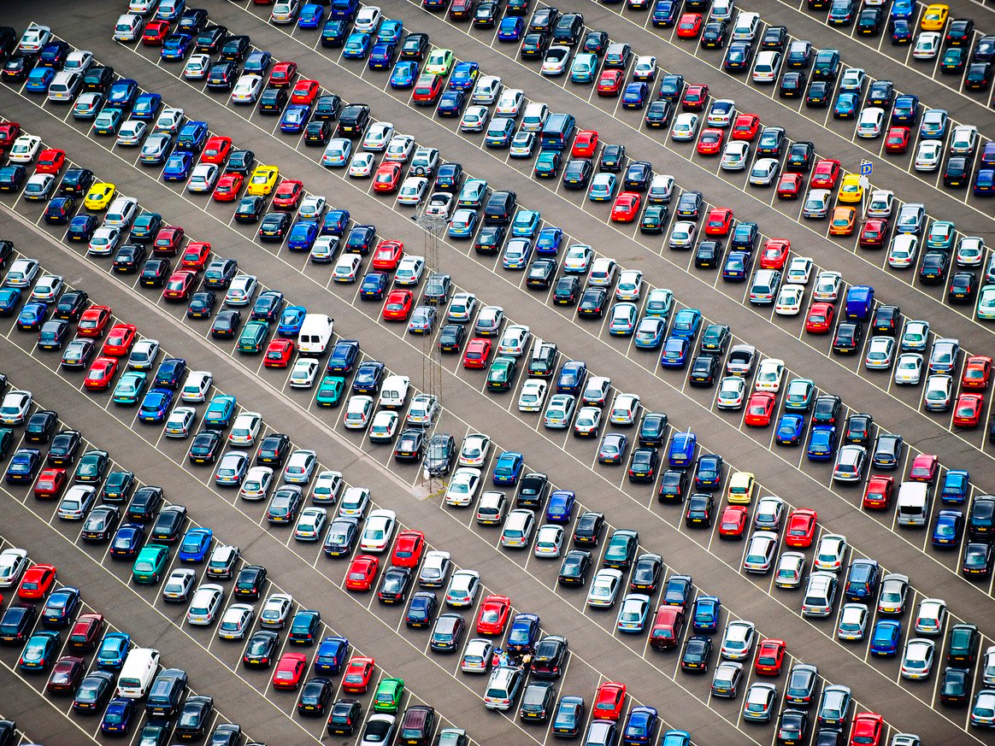

SJSU Parking Database Management
Department of Applied Data Science San Jose State University BUS243 Fall 2019 Group 2:
Jeehee Choi, Prathusha Koouri, Aparna Menon, Sukriti Mishra
Notes:
(get attention from crowd)
How many of you have faced or heard of parking issues on campus? please raise your hand.(many)
okay quite a lot of you. thank you.
(explain how we got interested in this problem and want to do this project)
I also have same challenges. Several times I’ve waited more than an hour to find a parking lot or paid to park at a private parking lot because I couldn’t find a parking lot. With these experiences, my team wanted to study a prototype of San Jose State University’s current parking status and challenges.

Slide 2






Contents
Introduction
SJSU Parking System Description
ER Diagram
Queries and Graphs
Conclusion
Future Scope
Notes:
we’ll walk you through introduction, some descriptions about current sjsu parking system, an ER diagram, queries with graphs, conclusion and future scope.

Slide 3


Introduction
INTERVIEWED SJSU PARKING SERVICES MANAGERS
RESEARCHED
Notes:
this is how we approached parking database management project.
we had face to face and phone call interviews with a parking services manager,
researched types of parking data/policies from SJSU parking services website,
googled SJSU’s campus master plan for parking,
and found new articles about future parking garage plan.
Through these interviews and researches, we learned more about the current status and challenges of SJSU’s parking system.

Slide 4
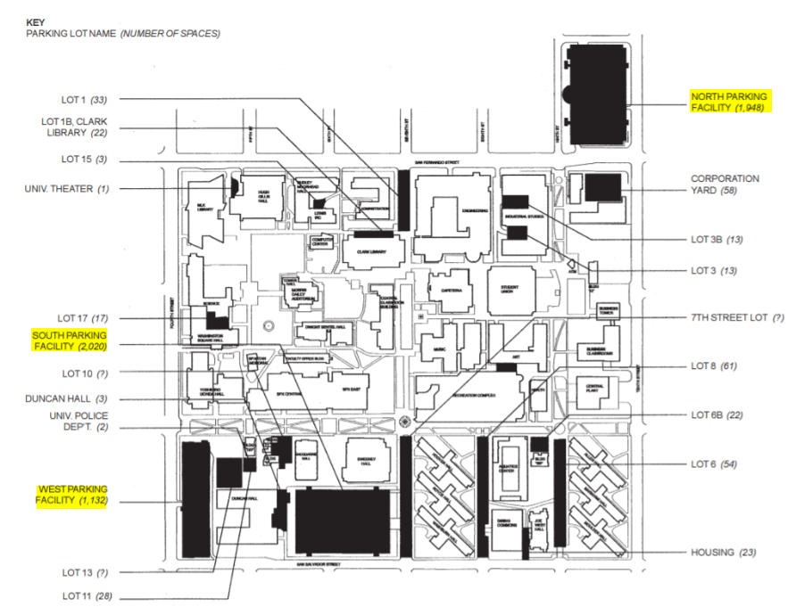
SJSU’s Parking System
SJSU parking spaces: 6,600
Campus population: over 36,000 students & 4,300 employees
Notes:
citation: http://www.sjsu.edu/fdo/departments/pdc/whatwedo/masterplan/ pg2-13
San jose state university has West Garage, South Garage, North Garage , Surface Parking Lots on main campus, and Park & Ride Lot in south campus. SJSU has total of 6600 parking lots with , while over 40,000 campus population according to the SJSU website.

Slide 5
Objectives
Detailed study of parking infrastructure, permit types and operations
Identify entities in the parking database and establish relations among the entities
Create ER diagram and generate a database
Find insights from the database to make the parking system more efficient by using sql queries

Slide 6



Major challenges
Lack of parking spaces for students
Preference of certain parking lots over others
Low turnover of cars in lots
Notes:
(approximately 36,000 students and nearly 4,300 employees). This means 1 parking lot is allocated for every 5.5 students while national average parking lot is 1 parking lot per 2 students.

Slide 7





Business Plan
Improve parking system efficiency by:
Identifying the consumer base
Classifying the number of permit holders in each category
Exploring the most preferred parking lots by different permit holders
Detecting overstaying by permit holders, if any
Finding the most frequently issued citations
Notes:
Our aim is to improve the parking system efficiency by addressing gaps in the system. This could be done by:

Slide 8
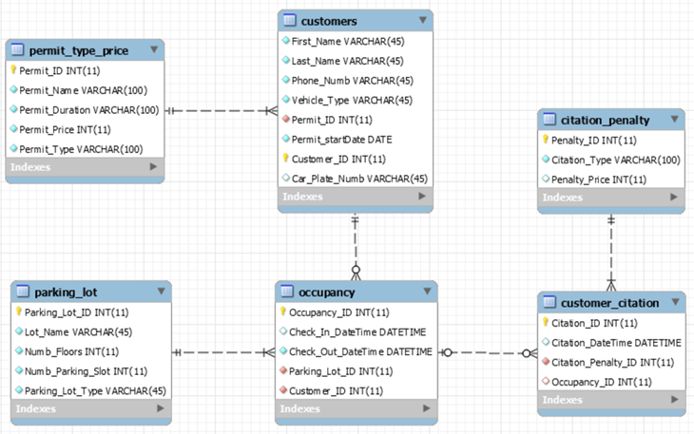
Parking Database ER Diagram
Notes:
data normalization, data cleansing (check in date and check out date)
we have acquired parking lot, permit price by type, citation penalty table data from SJSU parking services website while dummy data were created for customers, occupancy, and customer citation tables.
one to many, many to many

Slide 9
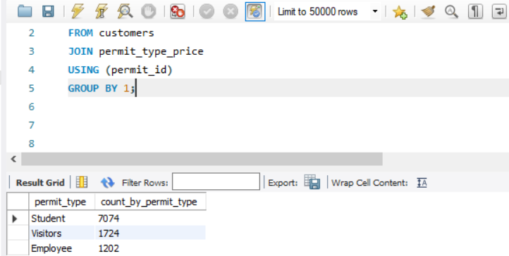
Query 1) How many permits are issued for students, visitors and employees each?

Slide 10
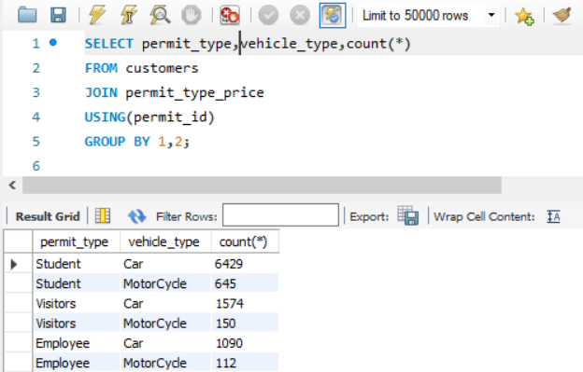
Query 2) What are the different vehicle types used by permit holders?

Slide 11
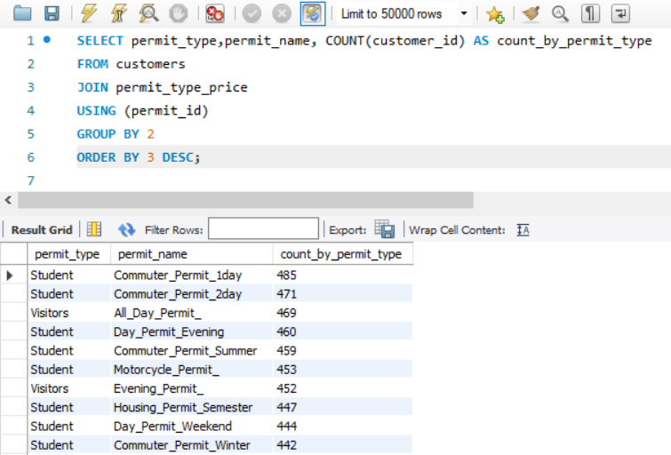
Query 3) What is the number of permits issued by permit name?

Slide 12
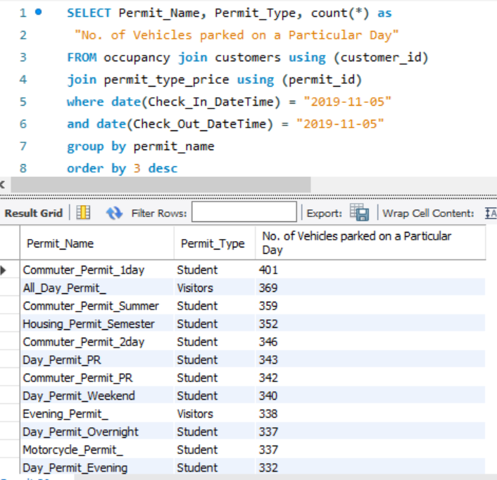
Query 4) How many vehicles are parked on a random day categorized by permit_type.

Slide 13
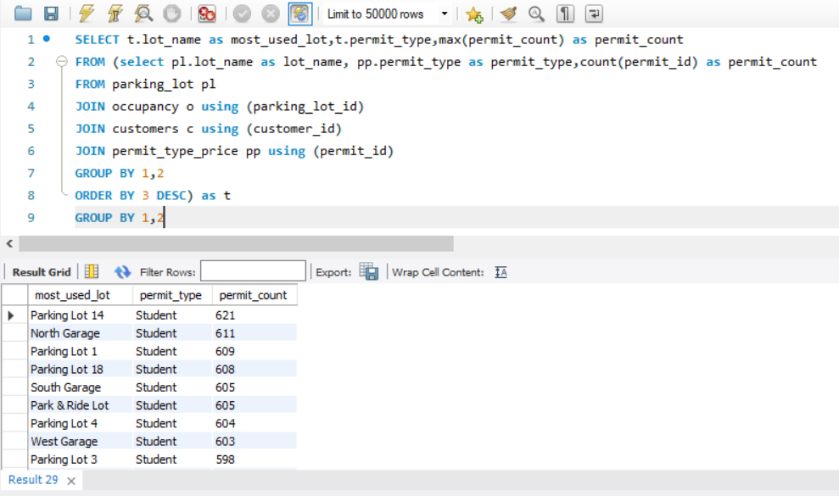
Query 5) What is the occupancy distribution in different lots by permit type?

Slide 14
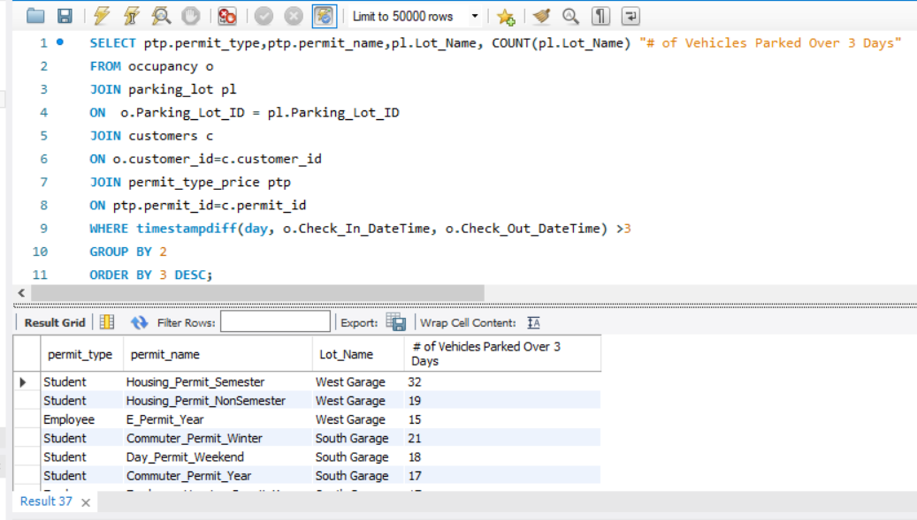
Query 6) How many vehicles by permit type that are parked for more than three days in different lots?

Slide 15
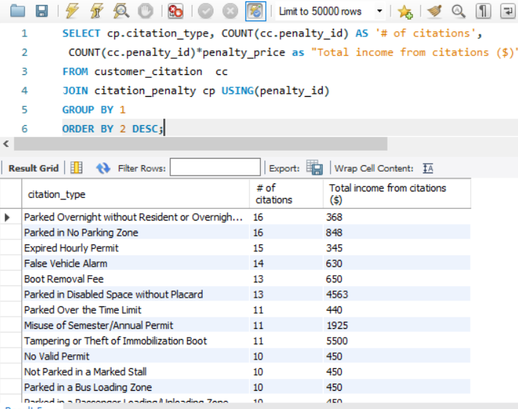
Query 7) What is the revenue generated by each citation type?

Slide 16
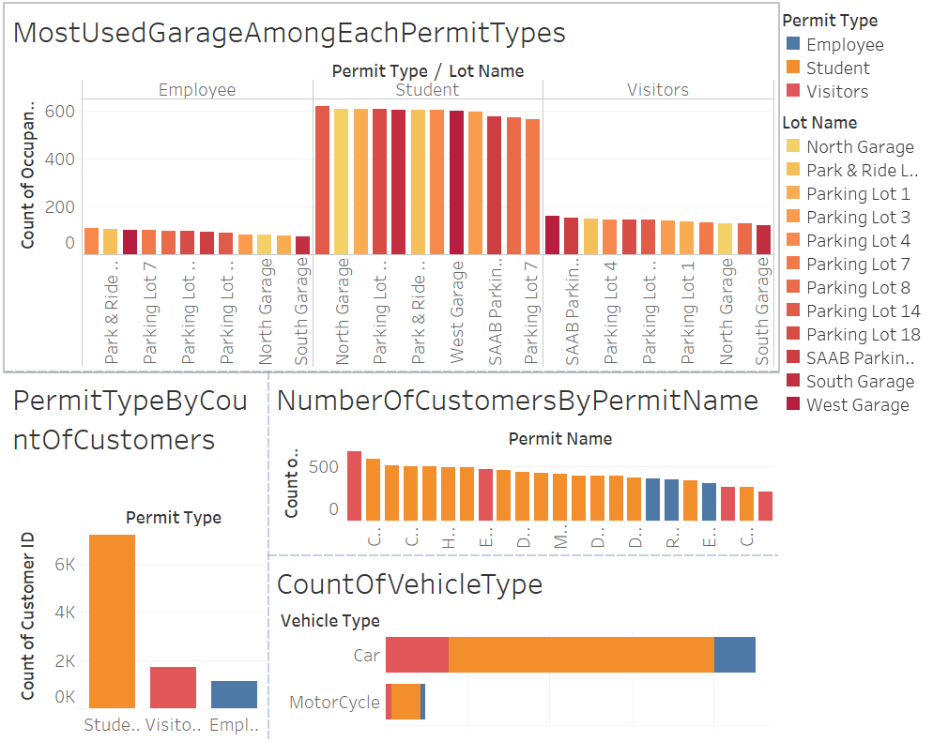
Analysing Permit Types and Customer Data

Slide 17
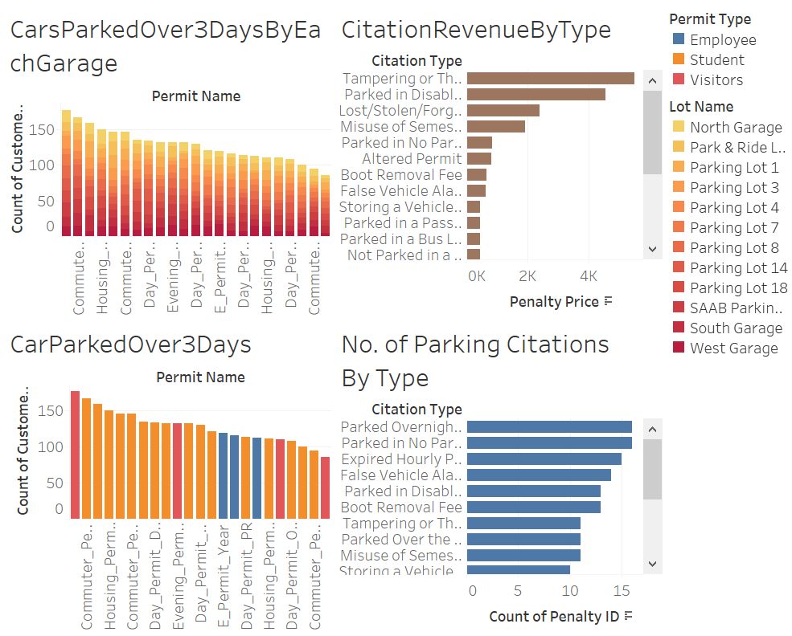
Analysing Citation data

Slide 18




Conclusion
Starting with identifying entities, relationships and designing an ER diagram, we forward engineered to create this smaller replica of SJSU parking database. We downloaded the required fictitious data from mockaroo.com.
Analyzed the data and explored the consumer base. We looked at the counts of different types of permits issued, vehicle types of permit holders etc.
Identified violation of parking hours by different permit holders
Analyzed the revenue from different citations.

Slide 19
Future Scope:
Work on
Work on SJSU real time parking datasets
Perform and analyze
Perform and analyze the machine learning algorithms for the real dataset and work towards a smart parking system.
Explore
Explore alternative modes of commute for effective parking management system using real time dataset
Notes:
Our aim is to work on SJSU real time parking datasets as we analyzed and performed our queries on the fabricated datasets.
Perform and analyze the machine learning algorithms for the real dataset to make parking system automatic and more towards smart parking system.
From the real time dataset results, we can create alternative modes of commuting for effective parking management system.

Slide 20


